Slide 1


Food Waste Footprints:
Uncovering Country-Level Contributions to the Issue
Author: Vincenzo Civale
Email: civalevincenzoyuto@gmail.com
Cartella Drive con Script SQL

Slide 2

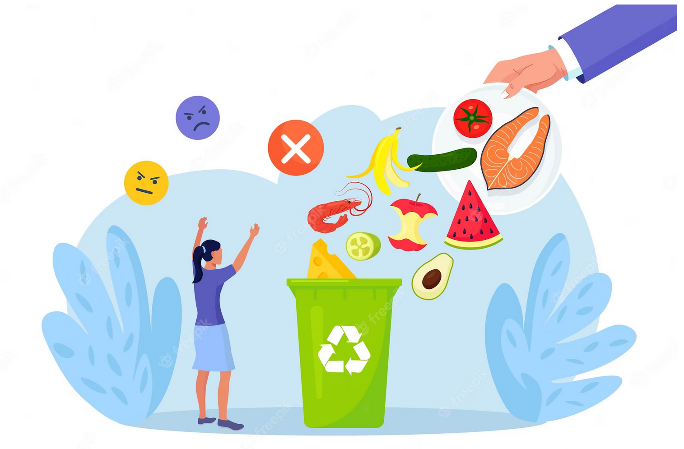
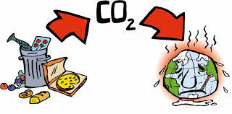
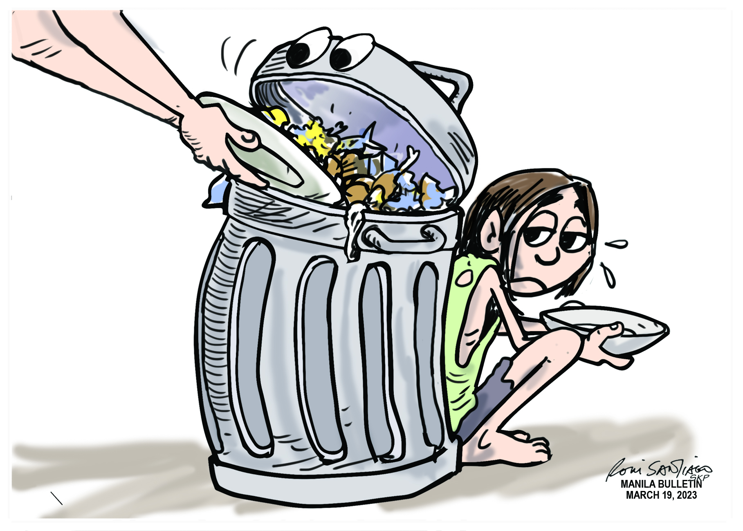
Global Food Waste
The lack of consumer awareness and education on food preservation, coupled with policies within the modern food industry, contribute to an annual increase in food waste.
Food production uses valuable resources. Wasting food means wasting those resources. Furthermore decaying food in landfills releases greenhouse gases, worsening climate change. Meanwhile, many go hungry while food is wasted. Tackling food waste is crucial for both efficiency and social fairness.

Slide 3
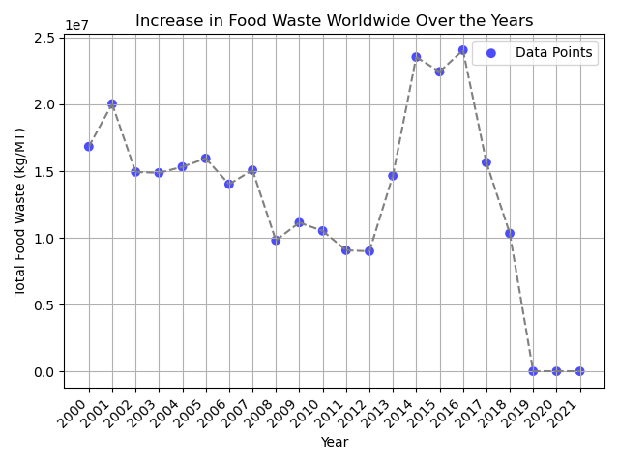
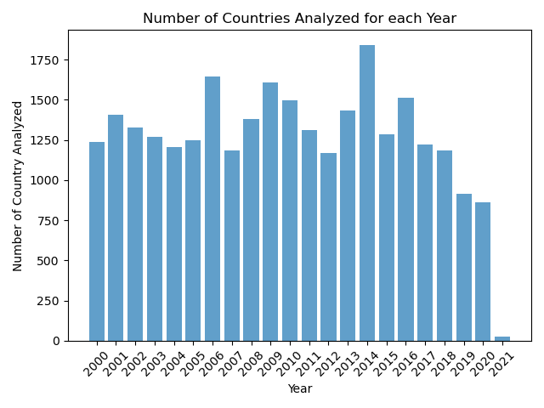
Food Loss and Waste Dataset
The Food and Agriculture Organization (FAO), which is a specialized agency of the United Nations, whose primary goal is to combat hunger and improve agricultural practices.
The project uses FAO-provided data, encompassing a broad array of statistics related to agriculture, food, and global food security.
The data analysis reveals a limited amount of information for the most recent years, leading to the decision to rely on data from the year 2018.

Slide 4
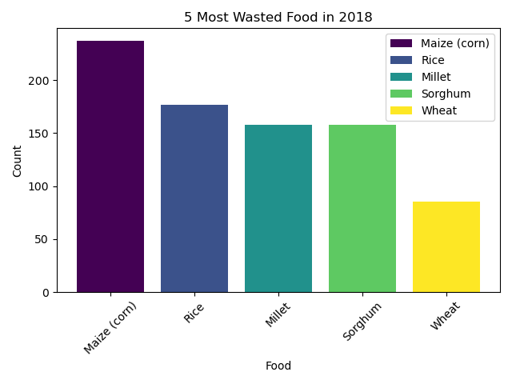
Most Wasted Food
Specific food items are more prone to being wasted due to shorter shelf lives, frequent aesthetic imperfections, or because they are often subject to over-purchasing, where consumers buy larger quantities than needed.

Slide 5
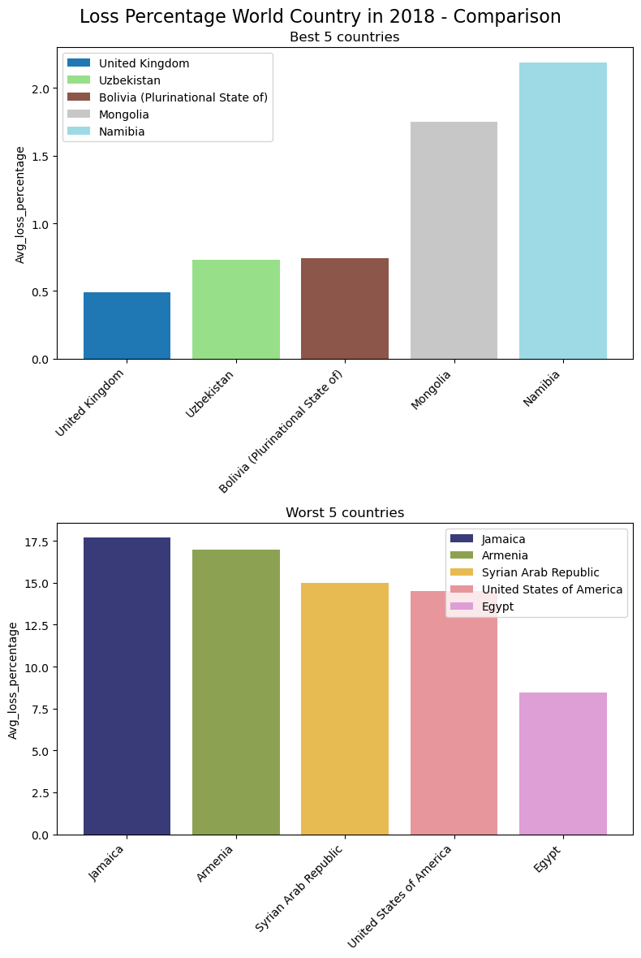
Top and Worst 5 Countries
To compare countries' commitment to this issue, the measures of Loss Percentage were compared, which indicates the level of waste relative to the amount of available food.
On the right, two graphs are displayed: one representing the percentages of the most conscientious countries, and the other depicting countries with higher waste percentages, based on the 2018 data.

Slide 6
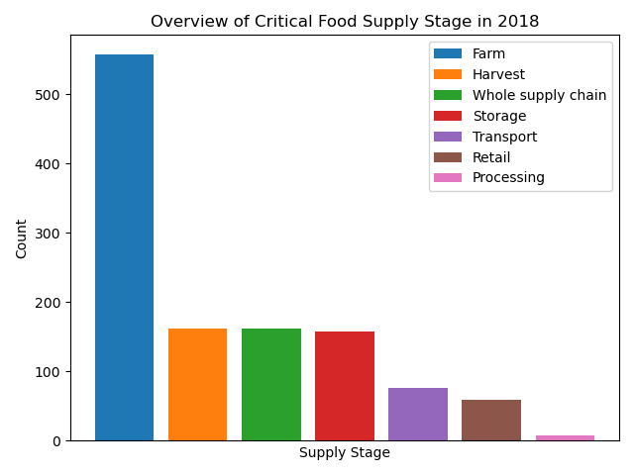
Critical Food Supply Stage
In addition, it was desired to determine which phase of the food supply was the most critical, based on the data from 2018.
In the adjacent chart, it can be observed that the most critical food supply stage is unequivocally the 'Farm' stage.

Slide 7

Data Science Battling Hunger & Food Waste
Predicition of Supply and Demand
Increase Citizens Awareness
Global Collaboration
Field Specific Optimization

Slide 8
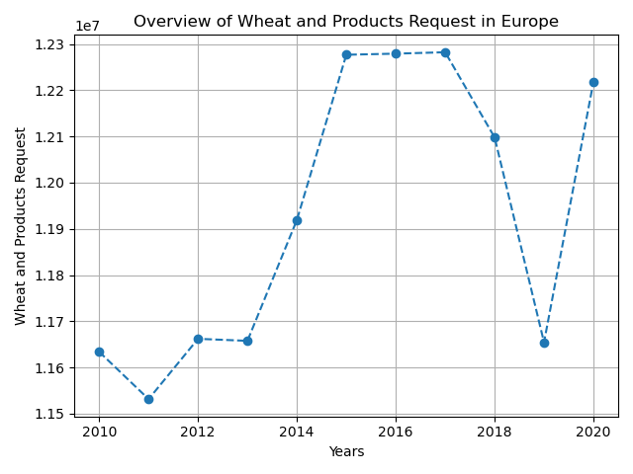
Prediction of Supply Demand
If food production exceeds actual demand, surpluses can accumulate that may deteriorate or expire before being consumed.
Utilizing additional datasets, such as the one created by FAO, predictive models of each food category's demand in every nation can be developed. This enables the organization of production that meets demand without excess.

Slide 9

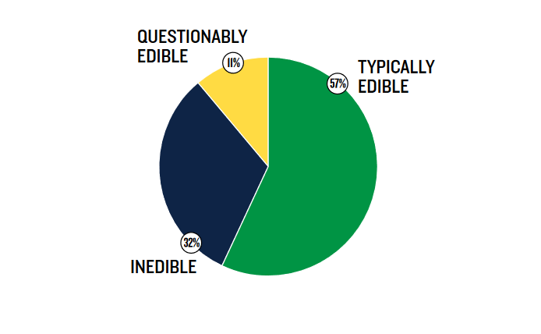

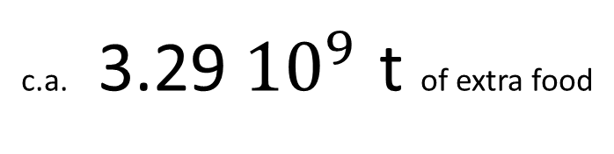
Increase Citizens Awareness
FOOD WASTED BY EDIBILITY BY WEIGHT IN USA
A significant portion of the food wasted in households is due to citizens' unawareness of what has expired and what is still edible
By saving only the 'typically edible' food in the USA in 2018, there would have been:
c.a. 3.29 ${10}^{9}$ t of extra food
Source: ” Estimating Quantities and Types of Food Waste at the City Level” by Darby Hoover from the Natural Resources Defense Council (NRDC)

Slide 10
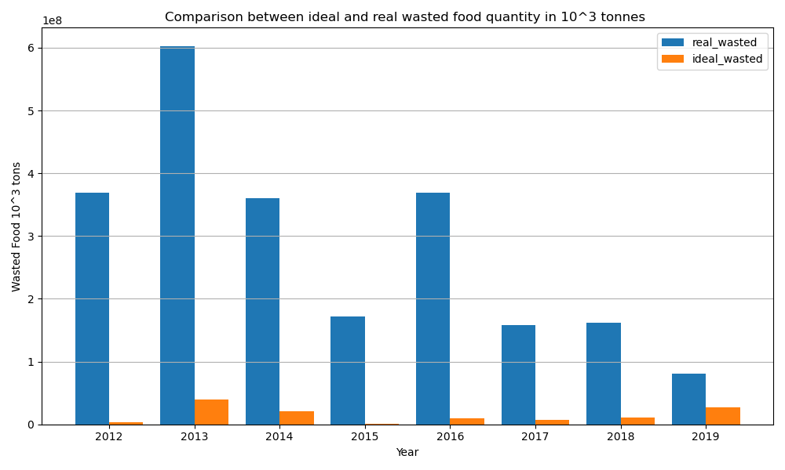
Global Collaboration
In the chart, the difference in wasted food in 1000 tons is displayed if all nations had a loss percentage equal to the minimum of each year

Slide 11
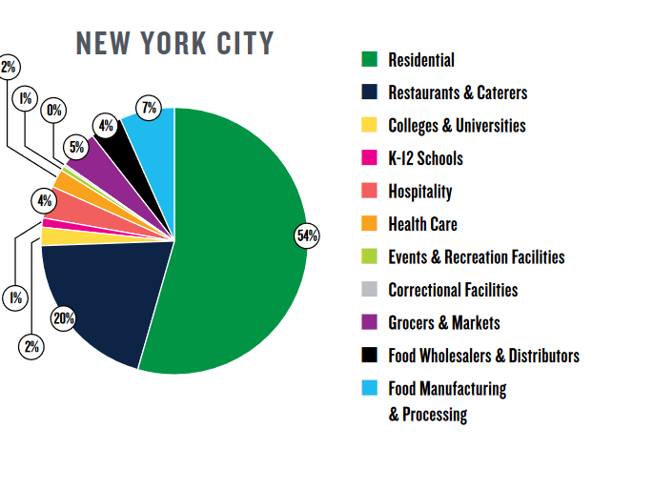
Field Specific Optimization
Optimizing processes through the analysis of each sector to reduce food waste would significantly mitigate the environmental impact. Solutions that identify the challenges within each field could effectively address these issues.
Source: ” Estimating Quantities and Types of Food Waste at the City Level” by Darby Hoover from the Natural Resources Defense Council (NRDC)

Slide 12
Food Waste Footprints:
Uncovering Country-Level Contributions to the Issue
Author: Vincenzo Civale
Email: civalevincenzoyuto@gmail.com
Cartella Drive con Script SQL

